Slide 1
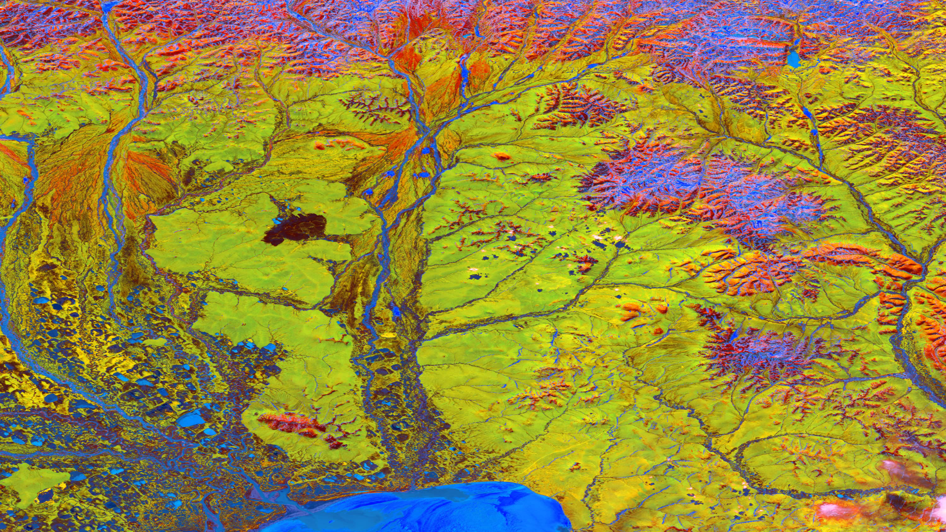
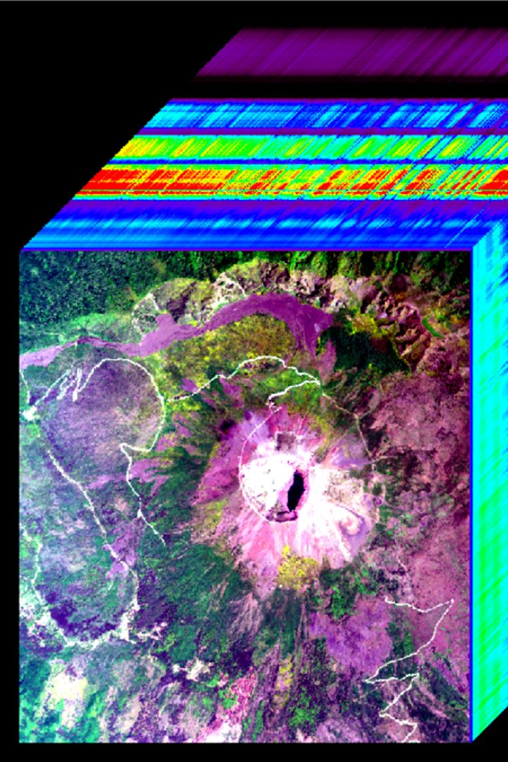
Signal Processing Approach In Hyperspectral Unmixing
By
Sai Keerthana 222010322001
Ssrk Kasyap 222010322005
Sharan Kumar 222010322043
Ramkoteswara rao 222010323002

Slide 2
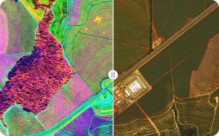
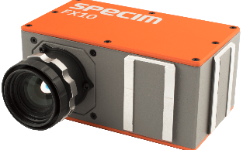
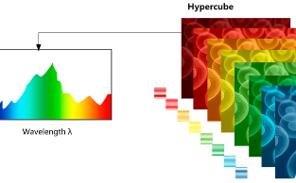

Introduction
Definition
Why Hyperspectral Imaging?
Visualizing Hyperspectral Data
Applications
Technique that analyzes a wide spectrum of light instead of just assigning primary colors (red, green, blue) to each pixel.
Hyperspectral cameras capture an image at many different wavelengths, providing a wealth of information about the imaged scene.
Each pixel in a hyperspectral image can have hundreds of associated measurements.
Geosensing, Environmental monitoring, precision agriculture, mineral exploration, medicine, and more.

Slide 3
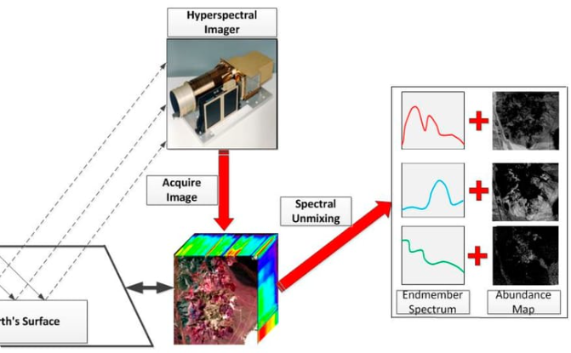

Foundational Methods
High-Resolution Hyperspectral Imaging via Matrix Factorization
Non-Negative Sparse Promoting Algorithm for High-Resolution Hyperspectral Imaging

Slide 4
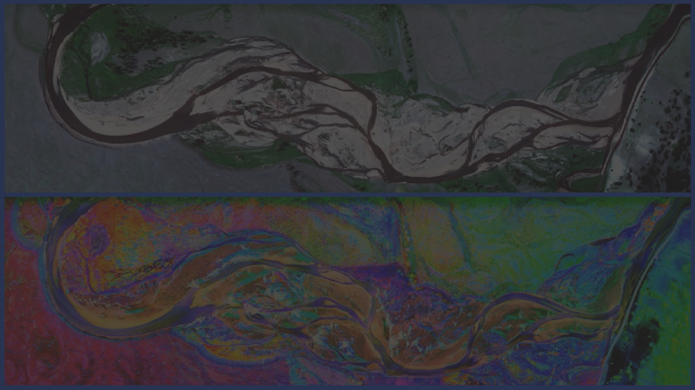
Matrix Factorization for High-Resolution Hyperspectral Imaging
Aim
Requirements
End result
Introducing a revolutionary solution that enables the reconstruction of exceptionally high-resolution hyperspectral images
A lower-resolution hyperspectral image and a high-resolution RGB image.
High-resolution hyperspectral image.
Significant advancements in hyperspectral imaging technology

Slide 5
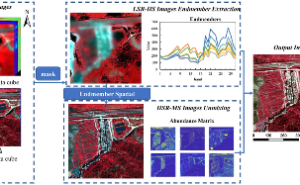
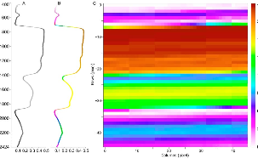
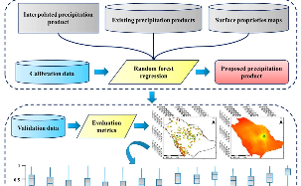
Matrix Factorization for High-Resolution Hyperspectral Imaging
Stage 1: Unmixing Algorithm
1
Reflectance Spectra
2
Recovering Information
3
Methods used
Estimates a basis representing the scene's underlying reflectance spectra.
Recovers crucial information lost during conventional RGB image capture.
Unmixing problem transformed into sparse matrix factorization, addressed through
` ℓ1 –minimization.
Stage 2: Data Fusion
Fusion of Data Sources
Enhanced Image Generation
Ultimate Goal
Combining Reflectance Spectra Basis and High-Resolution RGB Image
Generating High-Resolution Hyperspectral Image through Data Fusion
Achieving Remarkably Detailed Hyperspectral Image

Slide 6

Matrix Factorization
Method
Proposes an algorithm that operates under assumptions of randomness and sparsity.
Takes advantage of the inherent sparsity to achieve efficient factorization.
Utilizes randomness to enhance the exploration .
1
2
3
Basic principles
Advantages
Provides a method for decomposing a matrix into sparse components, enhancing interpretability and enabling efficient storage and processing.
Improved Interpretability
Data Compression
Noise Reduction

Slide 7
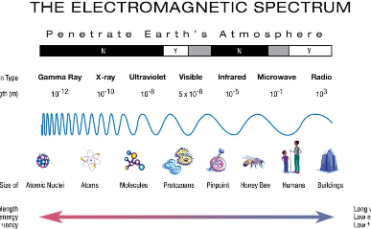


ℓ1 Minimization for Spectral Selection
What is ℓ1 Minimization
Method
Advantages
Also known as ℓ1 regularization or Lasso used to select and emphasize crucial spectral bands while reducing the influence of less relevant wavelengths
Minimizing the sum of the absolute values of coefficients, promoting sparsity in the solution
Efficient Data Analysis
Increased Accuracy
Improved Efficiency
Selects a subset of wavelengths that contribute the most to the scene's unique spectral signature
Minimizes the sum of the absolute values of coefficients
Highlights the significant wavelengths
Reduces the influence of irrelevant wavelengths

Slide 8

Non-Negative Sparse Promoting Algorithm
1
What is Non-negative Sparse Promoting?
Non-negative sparse promoting is a technique for finding the sparsest solution to a set of linear equations subject to nonnegativity constraints.
2
How it Works
The Non-Negative Sparse Promoting Algorithm works by iteratively updating the coefficients of a model to minimize the objective function while enforcing non-negativity and promoting sparsity.
3
Applications
This Algorithm has various applications, such as feature selection, image denoising, and signal processing.
Its advantages include improved interpretability, computational efficiency, and better handling of high-dimensional data with limited resources.

Slide 9

Alternating Optimization Approach
1
What is Alternating Optimization?
2
How it Works
3
Applications
Starts with an initial solution and iteratively updates subsets of variables while fixing the others.
Machine learning, computer vision, signal processing, and data analysis.
Iterative technique that breaks down a complex problem into smaller subproblems
It is particularly useful in problems with multiple variables or constraints.
Aims to solve each subproblem sequentially
It optimizes one subset at a time, holding the remaining variables constant.
Tackling these subproblems individually
The advantages are: ability to handle large-scale problems, its flexibility and its convergence guarantees under certain conditions.
The process continues until convergence is achieved.

Slide 10
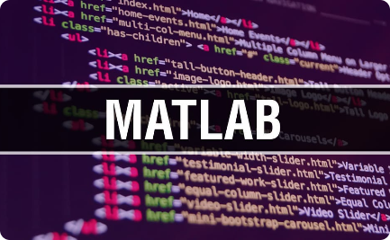
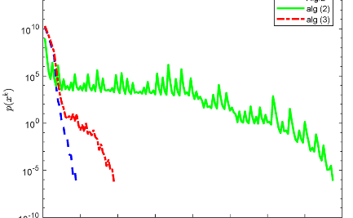
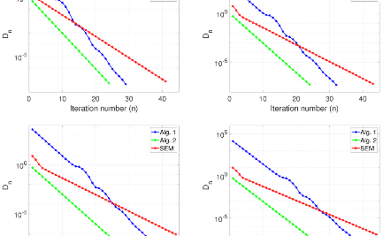
The Future Plan
Converting MATLAB program
Douglas Rachford Splitting Method
Bregman Algorithm
Minimizes a given objective function by iteratively updating a sequence of points.
Python programming has greater flexibility and scalability than MATLAB programming, so it will help to solve the problem more effectively and efficiently.
Iterative algorithm used to solve convex optimization problems.
It combines two steps, the Douglas step and the Rachford step.
Machine learning, signal processing, and image reconstruction.

Slide 11


